Slide 1


Protecting Code & Mutability

Slide 2


Protect Code
The single most important factor that distinguishes a well-designed component from a poorly designed one is the degree to which the component hides its internal data and other implementation details from other components.
A well-designed component hides all its implementation details, cleanly separating its API from its implementation.

Slide 3

Information hiding / Encapsulation,
Components then communicate only through their APIs and are oblivious to each others’ inner workings.
This concept, known as information hiding or encapsulation, is a fundamental principle of software design.

Slide 4

Information hiding / Encapsulation
Information hiding is important for many reasons:
Information hiding increases software reuse because components that aren’t tightly coupled often prove useful in other contexts aswell as the ones for which they were developed.
It separates the components of a system, which allows them to be developed, tested, used, understood, and modified in isolation.
It makes maintenance easier, because components can be understood more quickly and debugged or replaced with little chance of affecting other components.
Information hiding is also used to prevent programmers from intentionally or unintentionally changing parts of a program.

Slide 5
How do we implement Information hiding? - Access control modifiers
Java has many facilities to help with information hiding. The access control mechanism The Java Language Specification (Chapter 6) specifies the accessibility of classes, interfaces, and members.
The accessibility of an entity is determined by the location of its declaration and which (if any) of the access modifiers (private, protected, and public) is used.
Proper use of these modifiers is essential to information hiding.
The rule of thumb is simple: make each class or member as inaccessible as possible.
In other words, use the lowest possible access level consistent with the proper functioning of the software that you are writing.

Slide 6
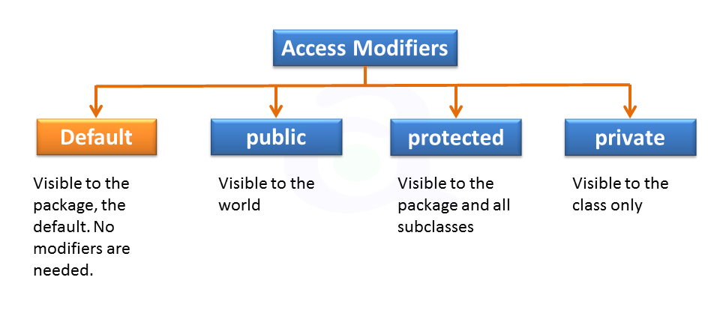
Access control modifiers
Java provides a number of access modifiers to set access levels for classes, variables, methods, and constructors.
The four access levels are:
https://www.atnyla.com/tutorial/access-modifiers-in-java/0/82

Slide 7
Default
Default access modifier means we do not explicitly declare an access modifier for a class, field, method, etc.
A variable or method declared without any access control modifier is available to any other class in the same package.
Private
Methods, variables, and constructors that are declared private can only be accessed within the declared class itself.
It is the most restrictive access level.
Variables that are declared private can be accessed outside the class, only if public getter methods are present in the class.
Using the private modifier is the main way that an object encapsulates itself and hides data from the outside world.

Slide 8
Public
A class, method, constructor, interface, etc. declared public can be accessed from any other class.
Therefore, fields, methods, declared inside a public class can be accessed from any class belonging to the Java Universe!
However, if the public class we are trying to access is in a different package, then the public class still needs to be imported.
Because of class inheritance, all public methods and variables of a class are inherited by its subclasses.
Protected
Variables, methods, and constructors, which are declared protected in a superclass can be accessed only by the subclasses in other package or any class within the package of the protected members' class.
Protected access gives the subclass a chance to use the helper methods or variable, while preventing a nonrelated classes from trying to use it.

Slide 9
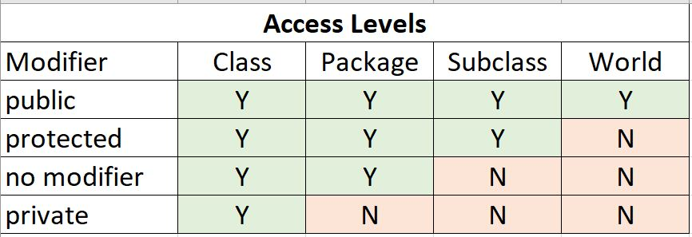
Access control modifiers

Slide 10
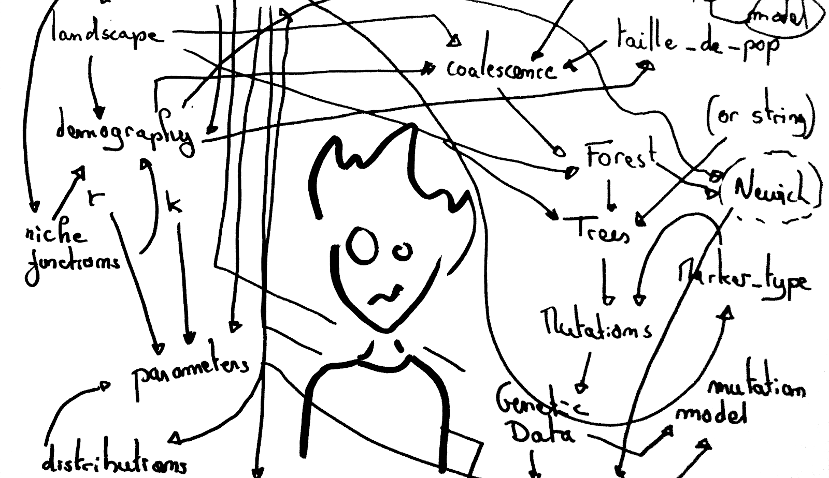
Why should a developer care about information hiding?
When applications become large it can be difficult to keep all of the details about how everything works in your head.
(Even if you’re the one who has written all the code!!)
It gets worse when there are multiple developers working in the same code base. (Think Team Project!!)

Slide 11
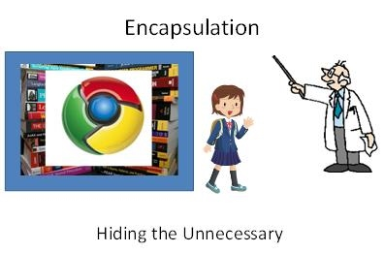
Why should a developer care about information hiding?
When the implementation of how an object accomplishes what it promises to do is hidden…
it enables a developer to trust that the object will do what it is supposed to do, even if they don't know how it does it!
Almost every programmer expects this out of their libraries, but rarely do they expect it from their own code.
Information hiding (Encapsulation) makes immutability possible
Meaning things that you do not want other people/classes to know are to be hidden.
For example a lecturer does not need to know how you have done your assignment. They are more interested in the end product.

Slide 12
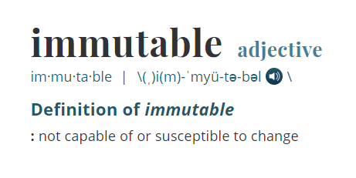


Slide 13

Immutability in Code..
An immutable object, is an object whose state cannot be changed once it has been created
examples:
String
Integer
Double
Are all immutable objects

Slide 14
Minimising mutability
"Classes should be immutable unless there's a very good reason to make them mutable.... If a class cannot be made immutable, limit its mutability as much as possible.“ (Bloch, 2018 )
An immutable class is simply a class whose instances cannot be modified.
All of the information contained in each instance is fixed for the lifetime of the object, so no changes can ever be observed.
Immutable classes are less prone to error and are more secure.
The Java libraries contain many immutable classes, the most well know is the String class.

Slide 15
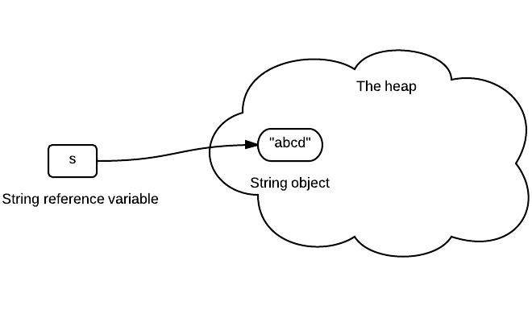
Most simple example is the String object.
1. Declare a string
String s = “abcd”;
The variable s stores the reference of a string object as shown.
The arrow can be interpreted as "store reference of"

Slide 16
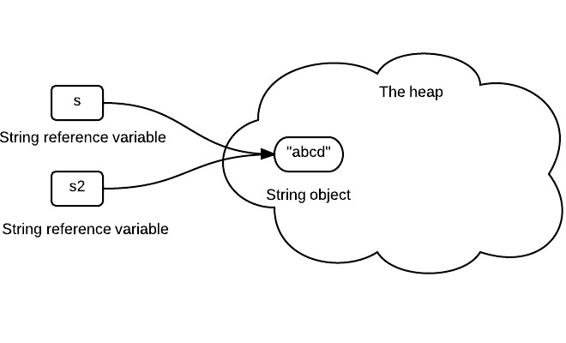
Immutable object – String Example
2. Assign a string variable to another string variable
String s2 = s;
s2 stores the same reference value since it is the same string object.

Slide 17
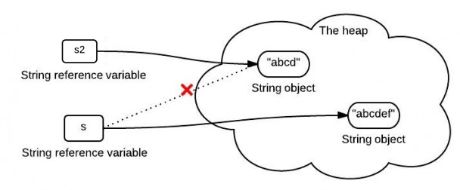
Immutable object – String Example
3. Concat string
s = s.concat(“ef”);
When we concatenate a string "ef" to s, s stores the reference of the newly created string object

Slide 18

Another String Example…
So, once a string is created in memory, it can not be changed. All methods of String do not change the string itself, but rather return a new String.

Slide 19
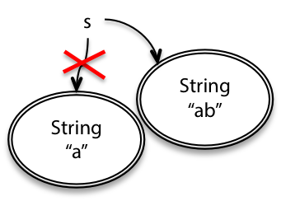
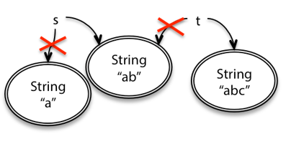
String Example
String s = "a";
s = s.concat("b");
//s=s+"b"
String t = s;
t = t .concat("c“);

Slide 20
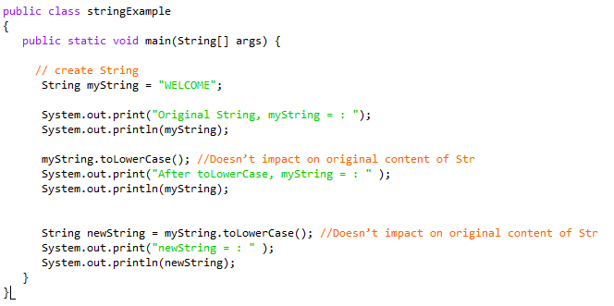

StringTest.java
Output →

Slide 21
Getters and Setters (Accessors and Mutators)
Getter and Setter Methods
Also known as Accessor and Mutator methods
These are methods are used to give access to an object's instance variables.
Simple classes often have getters that return the associated instance variable and nothing more.
public String getName()
{
return name;
}

Slide 22
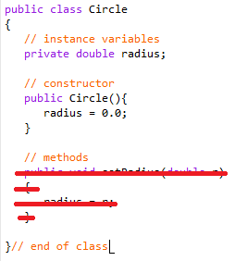
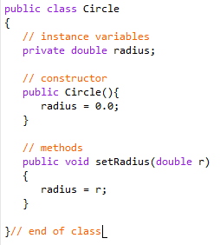
Immutable Objects and Classes
If the contents of an object cannot be changed once the object is created, the object is called an immutable object and its class is called an immutable class.
Lets look at the Circle class..
This class (currently) is mutable because it has a
set method for the radius!
If we delete the set method in the Circle
class, it would then be immutable because
radius is private and cannot be changed
without a set method.

Slide 23

Mutable Example!
Date is a Mutable Object!
Can be changed!!
Date

Slide 24
Person Birthday : 10/02/1992
Mutable
Date dateOfBirth = person.DateOfBirth;
Date tenDaysLater = dateOfBirth.AddDays(10);
System.out.println ("Date Of Birth: " + dateOfBirth);
What will it print out?
20/02/1992
Added 10 days
Also Added 10 days!!

Slide 25
Defensive Copying
Defensive Copying is a term used for immutable objects.
Meaning to defend the object from changing we make a copy of it for other objects to use.
Defensive copying is a technique which mitigates the negative effects caused by modifications (unintentional or intentional) of shared objects.
Instead of sharing the original object, we share a copy of it and thus any modification made to the copy will not affect the original object.
Imagine someone wanted to borrow your passport as they were booking you a flight.. But rather than give them your actual passport and risk not getting it back or getting it back if a different condition, you are more likely to make a photocopy of the original and give them that….

Slide 26
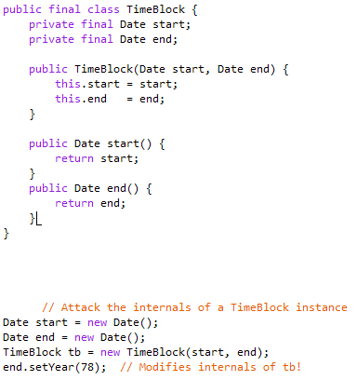
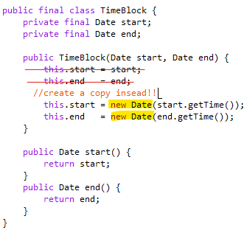
Notes:
public final class TimeBlock { private final Date start; private final Date end; public TimeBlock(Date start, Date end) { this.start = start; this.end = end; } public Date start() { return start; } public Date end() { return end; } } // Attack the internals of a TimeBlock instance Date start = new Date(); Date end = new Date(); TimeBlock tb = new TimeBlock(start, end); end.setYear(78); // Modifies internals of tb!

Slide 27
To make a class immutable, follow these five rules:
Don’t provide methods that modify the object’s state (known as mutators (or setter methods).
Ensure that the class can’t be extended. This prevents careless or malicious subclasses from compromising the immutable behaviour of the class by behaving as if the object’s state has changed.
Preventing subclassing is generally accomplished by making the class final.
Make all fields final. This clearly expresses your intent in a manner that is enforced by the system. Also, it is necessary to ensure correct behaviour if a reference to a newly created instance is passed from one thread to another without synchronization.

Slide 28
Make all fields private. This prevents clients from obtaining access to mutable objects referred to by fields and modifying these objects directly.
While it is technically permissible for immutable classes to have public final fields containing primitive values or references to immutable objects, it is not recommended because it precludes changing the internal representation in a later release.
Ensure exclusive access to any mutable components. If your class has any fields that refer to mutable objects, ensure that clients of the class cannot obtain references to these objects. Never initialize such a field to a client-provided object reference or return the field from an accessor (getter). Make defensive copies in constructor and accessor methods.

Slide 29
Immutable Objects and Classes
However…..
A class with all private data fields and without mutators (setters) is not necessarily immutable.
For example, the following class Student has all private data fields and no mutators, but it is mutable…..

Slide 30
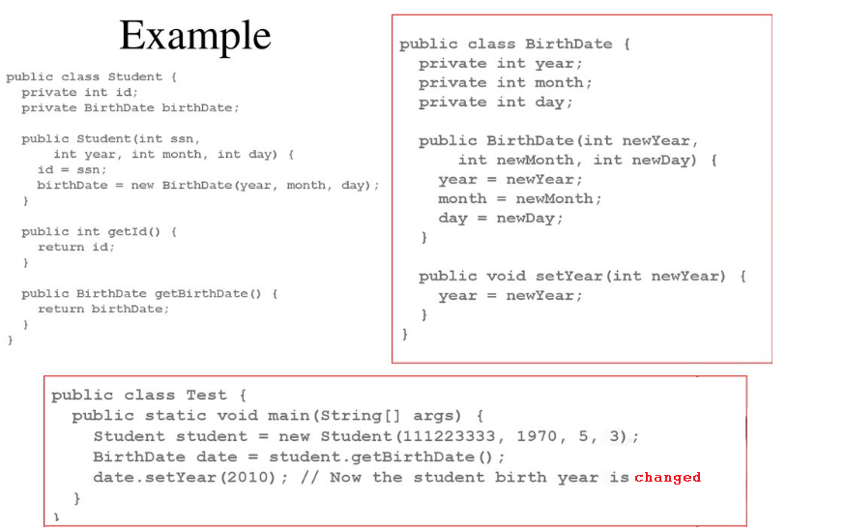

Slide 31
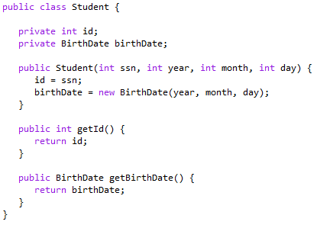
Student.java

Slide 32
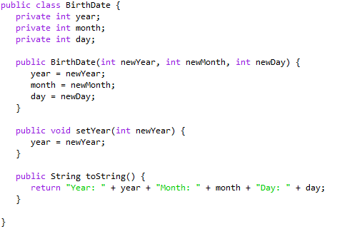
BirthDate.java

Slide 33
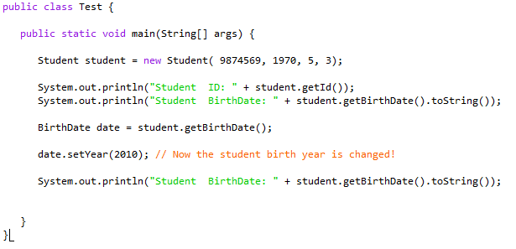
Test.java

Slide 34
Why do we need Immutable Objects?
When first learning OOP, developers typically create a very basic object and implement getters and setters (accessors and mutators).
After that, we think of objects as being data that we can influence or manipulate.
However, sometimes removing the ability to alter the data in an object can lead to more straightforward, more secure easier to understand code. This is the case with immutable objects.
While at first this may not seem very useful as often times the getters and setters are the first functions created for an object, there are many clear benefits to immutable objects.

Slide 35
Advantages of immutable
No invalid state - An immutable object remains in exactly one state, the state in which it was created. That also means that immutable objects are thread-safe so there is no synchronization issue. They cannot be corrupted by multiple threads accessing them concurrently.
Immutable classes are easier to design, implement, and use than mutable classes.
Immutability makes it easier to write, use (class invariant is established once and then unchanged).
Immutability makes it easier to parallelize program as there are no conflicts among objects.
The internal state of program will be consistent even if you have exceptions.
References to immutable objects can be cached as they are not going to change. Therefore provides fast operations.

Slide 36
Disadvantages of immutable
Creating an immutable class seems at first to provide an elegant solution. However…
whenever you do need a modified object of that new type you must suffer the overhead of a new object creation, as well as potentially causing more frequent garbage collections.
The only real disadvantage of immutable classes is that they require a separate object for each distinct value.

Slide 37
Advantages of immutability versus mutability
In Summary :
easier to design, implement, and use
can never be put into an inconsistent state after creation
references an object can be shared safely (confidently)
Thread-Safety
Immutable Types Are Always in a Valid State
No Need For Defensive Copying

